Slide 1
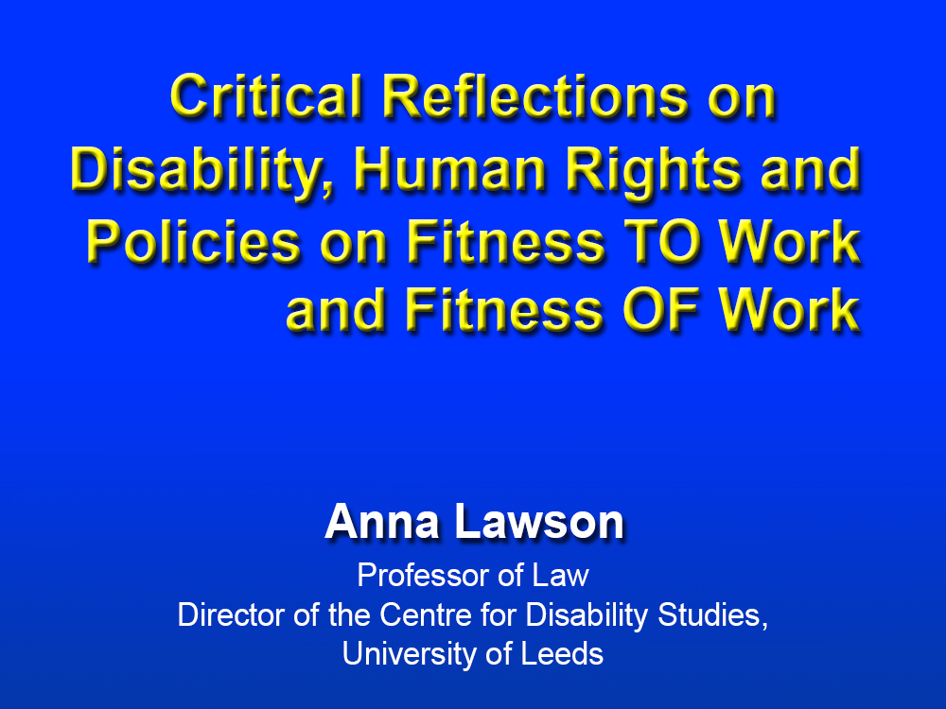

Slide 2
Structure of the Talk
1. Context
2. Viewing the Problem through Individual
and Social Model Lenses
3. Implementing the UN Convention on
the Rights of Persons with Disabilities
4. Rights to Reasonable Accommodation in the Workplace
5. Fitting Work for Disabled People
– Beyond Reasonable Accommodation?
6. Concluding Thoughts

Slide 3
Context

Slide 5
Context

Slide 6
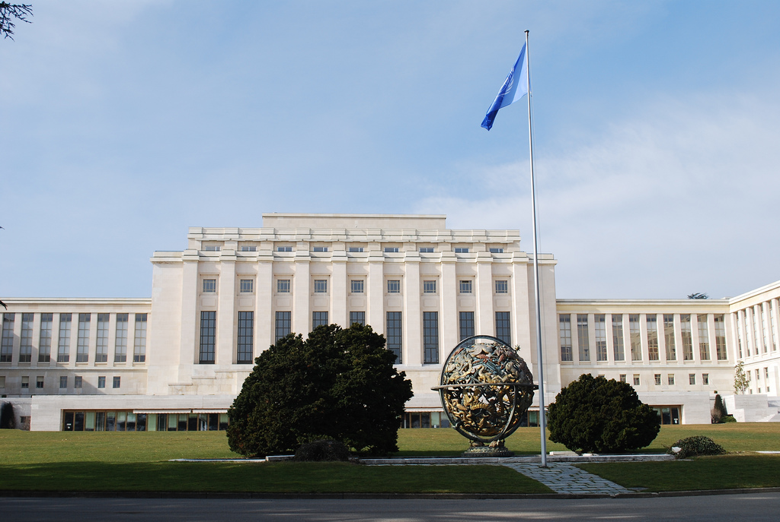
Context

Slide 7
Viewing the Problem through Individual and Social Model Lenses
The Individual Model Perspective

Slide 8
Viewing the Problem through Individual and Social Model Lenses
The Individual Model Perspective

Slide 9
Viewing the Problem through Individual and Social Model Lenses
The Individual Model Perspective

Slide 10
Viewing the Problem through Individual and Social Model Lenses
The Social Model Perspective

Slide 11
Viewing the Problem through Individual and Social Model Lenses
The Social Model Perspective

Slide 12
http://www.businessdisabilityinternational.org/old-way-or-new-way/

Slide 13
Rights to Social Protection
and an Adequate Standard of Living
Article 28 CRPD
Challenges
Associated with the formulation of capacity assessments
Associated with the process of capacity assessments

Slide 14
Rights to Social Protection
and an Adequate Standard of Living
Article 28 CRPD
A Rights-Based Disability-Inclusive Approach?
Article 28 CRPD
Disability-inclusive approach
Catalina Devandas Aguilar
(UN Special Rapporteur on the Rights of Persons with Disabilities)

Slide 15
Rights to Reasonable Accommodation
in the Workplace
Articles 2, 5 and 27 CRPD
What is Reasonable Accommodation?
Article 2 CRPD
Failure to provide it = discrimination
Individually-tailored
Limited by undue burden
Responsive

Slide 16
Rights to Reasonable Accommodation
in the Workplace
Articles 2, 5 and 27 CRPD
Reasonable Accommodation, the State and Employers
State required to place all employers under reasonable accommodation duties – Arts 5 and 27
State required to facilitate reasonable accommodation – Art 5(3)
Examples of challenges and successes

Slide 17
Fitting Work for Disabled People
– Beyond Reasonable Accommodation?
Accessibility
Accessibility standards
Procurement
Indirect discrimination

Slide 18
Fitting Work for Disabled People
– Beyond Reasonable Accommodation?
Tackling Prejudice and Changing Attitudes
Training re obligations
Training re good practice and colleague interaction

Slide 19
Fitting Work for Disabled People
– Beyond Reasonable Accommodation?
Leave and Flexibility
Disability Leave
Flexible Work Policies

Slide 20
Concluding Thoughts
Making Social Protection Schemes
universal and disability-inclusive
Requiring more inclusive employment
Combining Reasonable Accommodation Obligations with State Support

Slide 21
Concluding Thoughts

